Slide 1
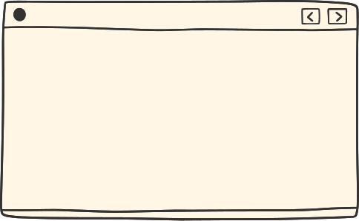




www.snakegameai.com
SNAKE GAME
AI Edition

Slide 2



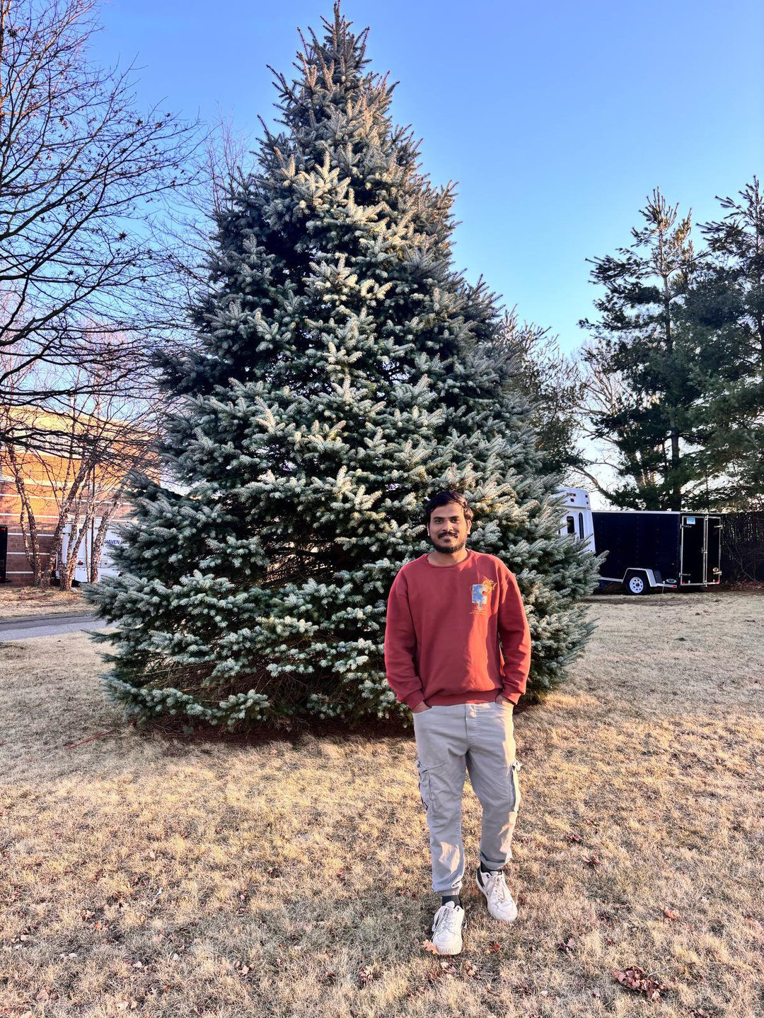
Ganesh
Akash
Naveen
We will be your Game Masters

Slide 3

Research proposal
Can a reinforcement learning agent develop survival strategies in a dynamic environment like Snake using only trial, error, and neural memory?
What does it take for an AI to learn how not to die in a game of Snake?
Can an AI learn survival instincts? Teaching a neural network to master Snake using curiosity, memory, and rewards ?

Slide 4




Objective
To develop an AI agent capable of learning how to play the classic Snake game autonomously using *Reinforcement Learning (RL)* techniques, particularly *Deep Q-Learning, implemented with **PyTorch* and visualized using *Pygame*.

Slide 5

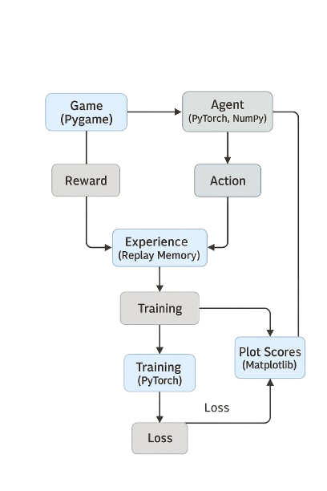
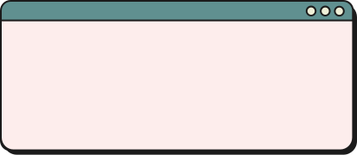



Scope
DATA FLOW
- Build the Snake game environment using *Pygame*
- Design a state representation for the agent
- Implement a Deep Q-Network (DQN) in *PyTorch*
- Train the AI agent using reinforcement learning
- Visualize training progress and evaluate performance
Tools & Technologies
- *Python 3*
- *PyTorch* – for building and training neural networks
- *Pygame* – for game rendering and environment simulation
- *NumPy/Pandas/Matplotlib* – for data handling and visualization

Slide 6


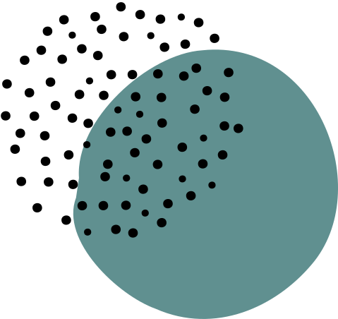

Deliverables
- Python source code (game + AI)
- Trained model
- Demo video or live presentation
- Final report / presentation slides
-Github link with project files
Expected Outcomes
- A trained AI that can play Snake effectively
- Visualization of training progress
- Insightful analysis of model performance and learning behavior

Slide 7


The snake moves continuously in one of four directions.
How we will play
Eating food increases the snake’s length and score.
The game ends if the snake hits a wall or itself.
Follow along and have fun!
Only one piece of food appears at a time on the grid.
The goal is to survive as long as possible and maximize score.

Slide 8
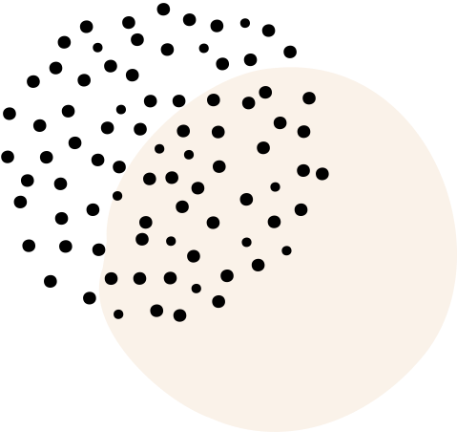


Thank You
Join us for another day for presentation!

